Slide 1
Marketing

Slide 2

Consumer Behavior

Slide 3
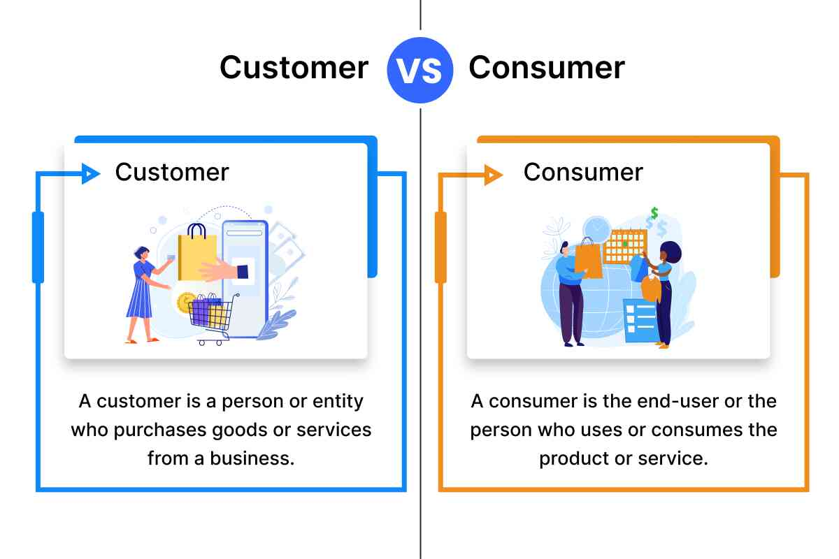

Slide 4

What motivates you to top-up your phone? - What urges you to upgrade your wardrobe?

Slide 5

Consumer motivation
Motivation is defined as the psychological process that initiates, guides, and maintains goal-oriented behavior.
Consumer motivation is an internal state that drives people to identify and buy products or services that fulfill conscious and unconscious needs or desires. The fulfillment of those needs can then motivate them to make a repeat purchase or to find different goods and services to better fulfill those needs.

Slide 6
Maslow’s Hierarchy of Needs

Slide 7
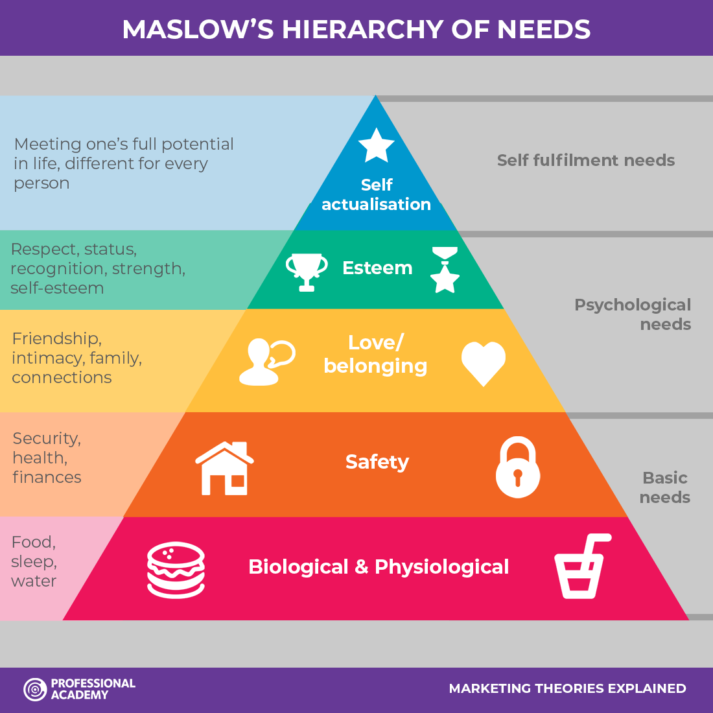
According to Maslow, human
needs are arranged in a hierarchy.
Starving people will take little
interest in the latest happenings
in the art world.

Slide 8
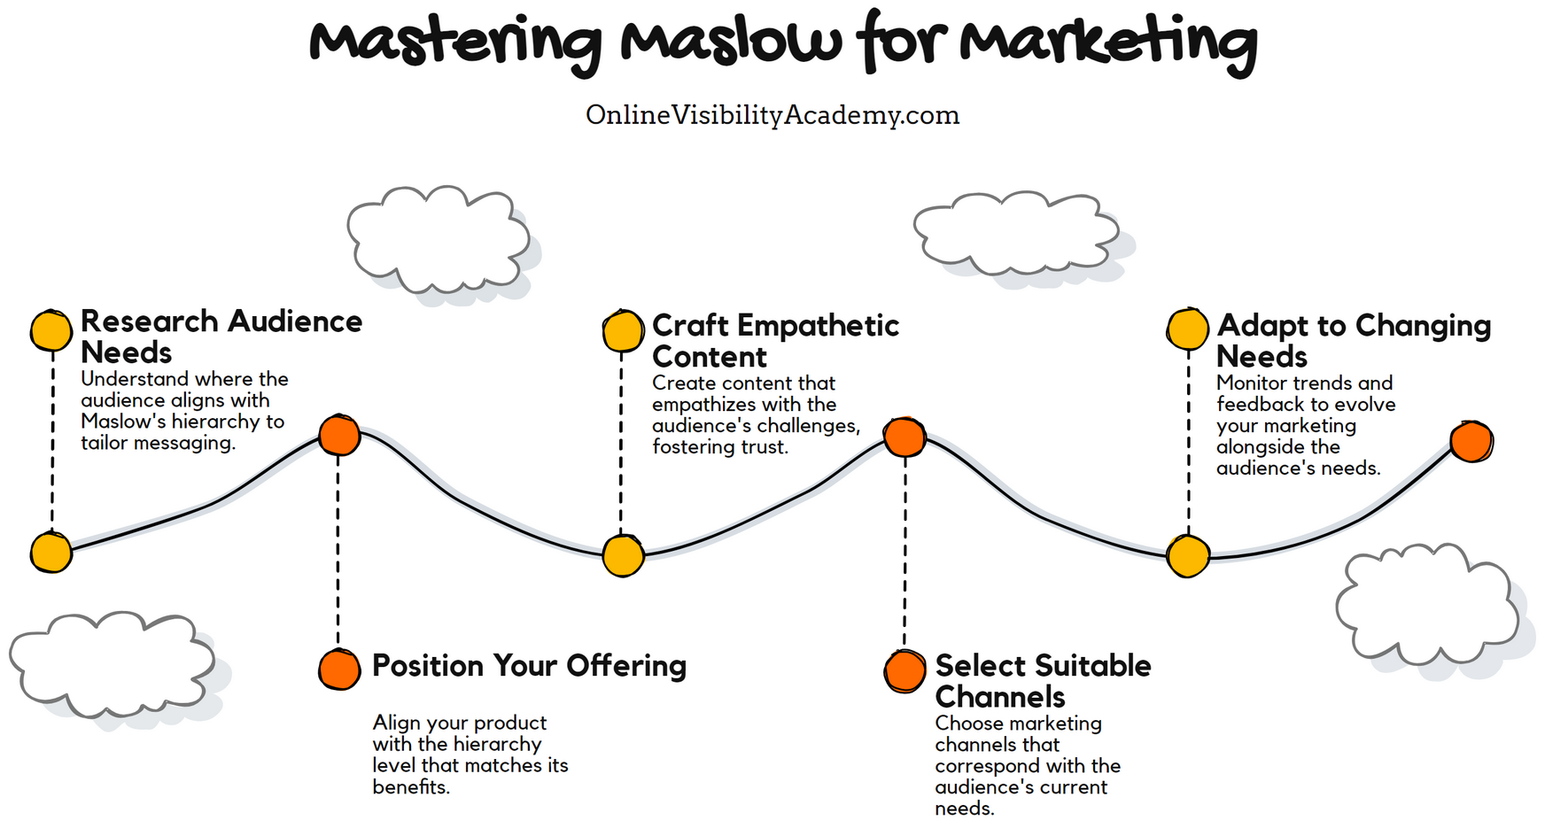

Slide 9

Perception
A motivated person is ready to act. How the person acts is influenced by his or her own perception of the situation. Perception is the process by which people select, organize, and interpret information to form a meaningful picture of the world.

Slide 10
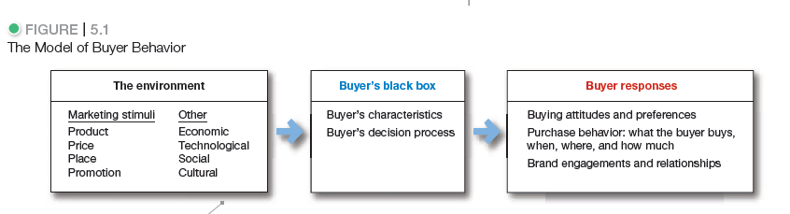
The Consumer’s buying Behavior model
Notes:
We can measure the whats, wheres, and whens of buyer
behavior. But it’s difficult to “see” inside the consumer’s
head and figure out the whys (that’s why it’s called
the black box).

Slide 11
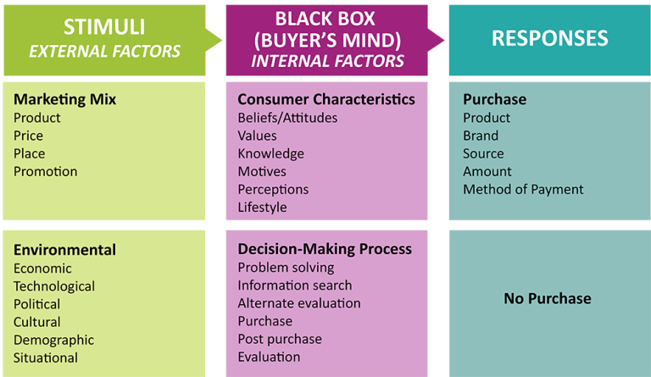

Slide 12
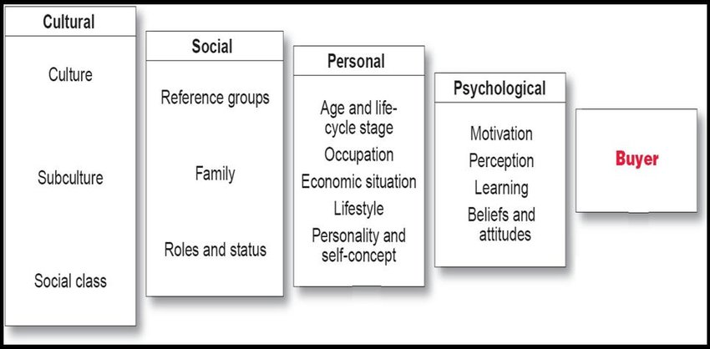
Factors affecting consumer’s buying behavior

Slide 13
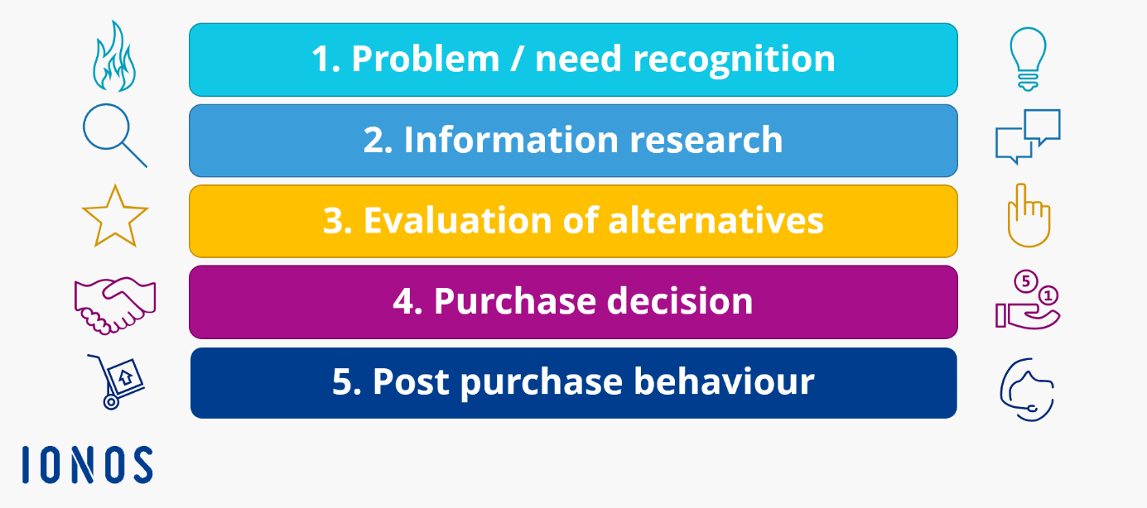
Buyer’s Decision Process

Slide 14
Buyer’s Decision Process
Need recognition: The first stage of the buyer decision process, in which the consumer recognizes a problem or need.
Information search: The stage of the buyer decision process in which the consumer is motivated to search for more information.
Alternative evaluation: The stage of the buyer decision process in which the consumer uses information to evaluate alternative brands in the choice set.
Purchase decision: The buyer’s decision about which brand to purchase.
Post purchase behavior: The stage of the buyer decision process in which consumers take further action after purchase, based on their satisfaction or dissatisfaction.

Slide 15
Role of Big Data in Marketing
Big data offers a snapshot of a business' user base, as trends, preferences and behavior patterns can be revealed through data analysis.
Market researchers use big data to analyze consumer data and understand their purchasing habits and opinions, which helps businesses make informed decisions about product development, marketing, and sales strategies.

Slide 16
Read and answer:
Bloggers can be highly influential. On the one hand, we react to their content because we value their opinions and ideas, but on the other, do we really know their motivations? There is a growing trend for social media and public relations agencies to approach bloggers to get them to “blogvertize” on their behalf. The agencies also insist that such bloggers make no mention of the fact that they are being paid to make positive statements about certain products and services. In the United Kingdom, the Advertising Standards Authority (ASA) state that it is acceptable for a blogger to receive payment for a positive review, but the blogger has to be clear that they are advertising. The ASA suggests signposting paid for posts. The ASA argues that just like any other media, consumers need to be able to judge whether or not they are seeing an advertisement. The clear rules are that advertisements must be obviously identifiable as such and not likely to mislead.
Have you encountered this type of blog posting before? Was it clear that the post was an advertisement? How might the fact that the blogger is being paid for an opinion change your view? Write a brief answer of your observations.

